Slide 1
Characteristics, applications and processing of polymers
Name: Imanol García Magaña
Student ID: 1889236

Slide 2
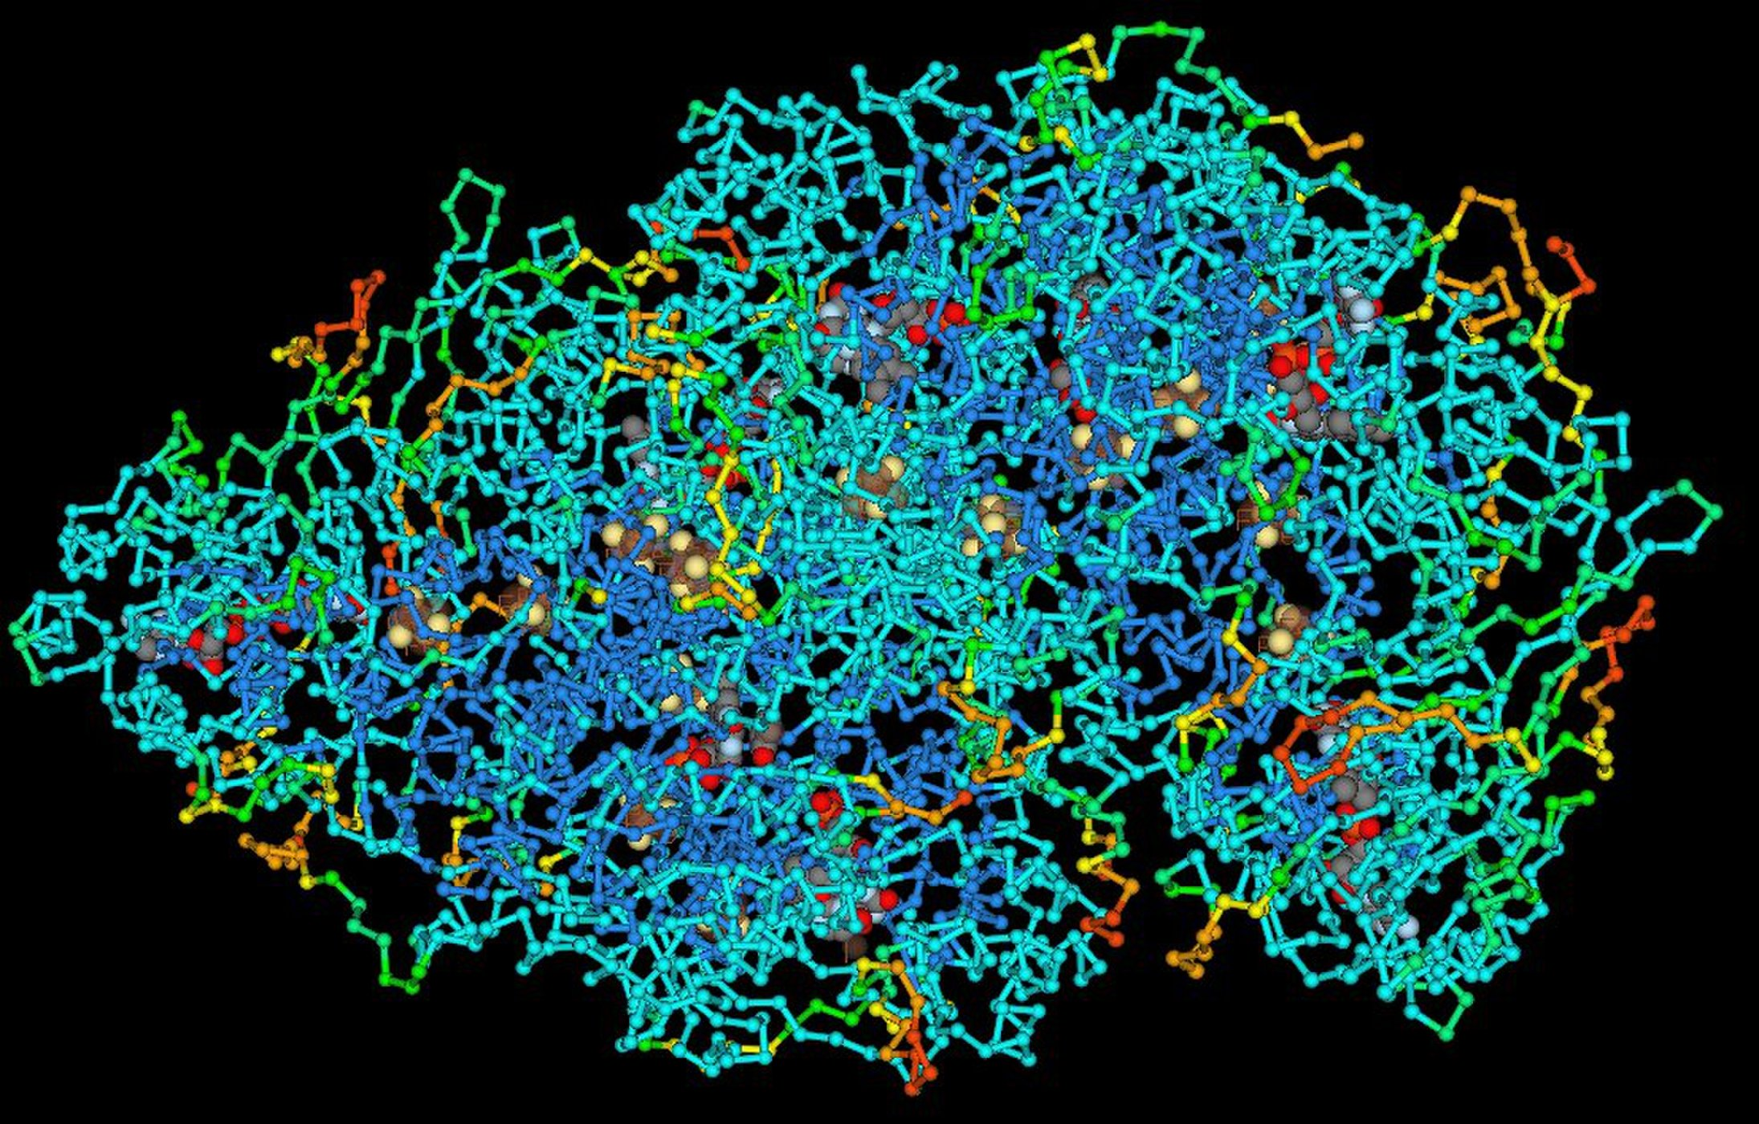
Definition
Polymers are materiales made of long and repeating chains of molecules. The materials have unique properties, depending on the type of molecules being bonded and how they are bonded.

Slide 3
Stress-strain behaviour
Based on the stress-strain behaviour, there are three classifications: brittle, plastic and highly elastic.
Change with temperature.
Sensitive strain rate.
High flexibility and resistance.
Low density.

Slide 4
Types of polymers according to their applications
Plastics:
- structural rigidity under load.
any degree of crystallinity.
Any molecular structures and configurations are possible.
thermoplastic or thermosetting.
Examples: Polypropylene, polycarbonate and polyethylene.

Slide 5
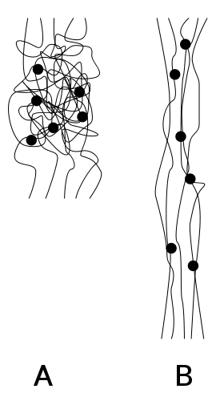
Elastomers:
Low modulus of elasticity.
High extensibility.
Examples: Neoprene, natural rubber and silicone.
Fibers:
High modulus of elasticity.
Low extensibility.
Examples: nylon, kevlar and nomex.

Slide 6
Adhesives:
High adhesion.
High cohesion.
Examples: Nitrocellulose, polyester silicone and cyanoacrylate.
Coatings:
Corrosion, scratch and wear resistance.
Adhesion.
Example: Latex.

Slide 7
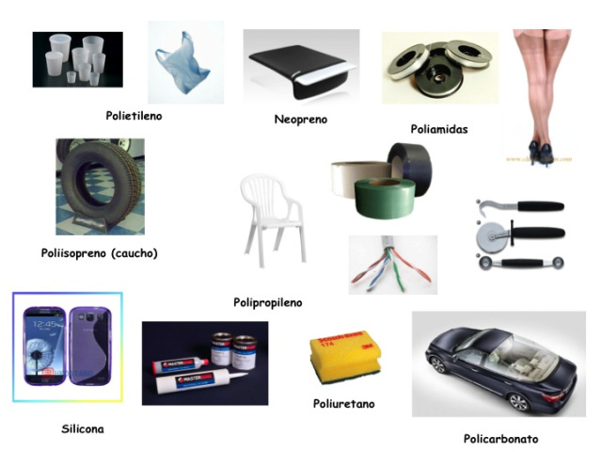
Applications of polymers
Structural materials.
Electric supercapacitors.
Drivers.
Solid supports for organic synthesis.
Packing.
Electrolytes.
Materials with non-linear optics.

Slide 8
Polymer synthesis and processing
Polymerization
Additive materials
Additive
polymerization
Condensation polymerization
Fillers, plasticizers, stabilizers, colorants and flame retardants.
Reaction of monomers without the elimination of atoms
Reaction in wich smalls molecules, such as water, is eliminated between functional groups

